Slide 1

MINI-PROJECT PRESENTATION
Academic Year (2024-25)
(IV/VI Semester)
Course Code:22CD49
Anomaly Detection in Networks Using ML
Presented By:
Under The Guidance Of
Prof. Bhagyashree Kulkarni
Assistant Professor
Dept. of CSE(Data Science)
DSCE, Bangalore
Name
Anna Banerjee
Dheekshva Rajkumar
Disha Sharma
USN
1DS23CD008
1DS23CD017
1DS23CD018
Department of CSE (Data Science), DSCE
1

Slide 2

CONTENTS
Abstract
Introduction
Problem Statement
Literature Survey
Motivation of the Project
Objective and Scope of the Project
Software & Hardware Requirements
System Design
  Existing System
Proposed System
Methodology
System Architecture
Technology Used
Working Model
Results
Comparative Analysis
Project Status
References

Slide 3
ABSTRACT
With the rapid growth of network usage and evolving cyber threats, traditional intrusion detection systems often fail to detect novel attacks effectively. This project presents a machine learning-based anomaly detection system that leverages algorithms such as Random Forest, Support Vector Machine, and K-Means clustering to accurately identify anomalous network traffic. Using benchmark datasets like NSL-KDD and CICIDS2017, the system incorporates data preprocessing, feature selection, and balancing techniques like SMOTE and PCA to enhance performance. The proposed model demonstrates high accuracy, precision, and recall, with reduced false positives compared to conventional methods. It also provides visualization tools for better interpretability and supports near real-time detection. This system offers a scalable and adaptable solution for improving network security, with scope for future advancements through deep learning and real-time deployment.
KEYWORDS: Anomaly Detection , Machine Learning ,Network Security , Isolation Forest , Dataset , Real time Detection
Department of CSE (Data Science), DSCE

Slide 4
INTRODUCTION
The increasing reliance on computer networks has made network security a critical concern, as cyber-attacks and intrusions continue to rise in frequency and complexity. Traditional intrusion detection systems (IDS), which depend heavily on signature-based methods, struggle to detect novel and evolving threats, often resulting in high false positive rates and limited adaptability. Anomaly detection, which identifies deviations from normal behavior, offers a more flexible and effective approach for uncovering both known and unknown attacks.
Machine learning techniques have emerged as powerful tools for anomaly detection due to their ability to automatically learn patterns from large volumes of network traffic and adapt to new attack vectors. This project aims to develop a machine learning-based anomaly detection system that can accurately classify network traffic as normal or malicious.
By using benchmark datasets like NSL-KDD and CICIDS2017, the system is evaluated for accuracy, precision, and efficiency. The ultimate objective is to create a scalable and reliable anomaly detection system that provides real-time insights and strengthens network security against advanced threats.
Department of CSE (Data Science), DSCE

Slide 5
PROBLEM STATEMENT
Traditional intrusion detection systems (IDS) primarily rely on signature-based techniques that are effective only against known attacks but fail to identify novel, unknown, or evolving threats. These systems also suffer from high false positive rates, lack of adaptability, and require constant manual updates to maintain effectiveness. As network environments grow more complex and the volume of network traffic increases rapidly, there is a pressing need for intelligent, automated systems that can accurately and efficiently detect anomalies in real-time.
The problem addressed in this project is the design and implementation of a machine learning-based anomaly detection system capable of identifying both known and unknown intrusions in network traffic. The system must overcome challenges such as data imbalance, high dimensionality, and evolving attack patterns, while ensuring scalability, low false positive rates, and near real-time operation to enhance the overall security of network infrastructures.
Department of CSE (Data Science), DSCE

Slide 6
LITERATURE SURVEY PAPERS/REFERENCES PAPERS
Sl. No. | Title of papers and Author | Year of Publication | Journal/ Conference Name | Methodology Used | Salient Features | Advantages/ Disadvantages
1 | "Machine Learning in Network Anomaly Detection: A Survey" ,byS. Garg, K. Kaur, G. Kaddoum, A. Bradai, M. Aloqaily, and M. Guizani | 2021 | IEEE Communications Surveys & Tutorials, vol. 23 | Anomaly Classification: Known vs. unknown anomalies. ML Techniques: Supervised, unsupervised, deep learning (CNN, RNN). Feature Extraction: Focus on relevant network features. Evaluation: Accuracy, precision, F1-score. | Covers traditional and modern ML methods. Emphasizes feature selection and data preprocessing. | Advantages: Scalable, adaptive to new anomalies Disadvantages: Needs high-quality data. Deep learning is resource-intensive
2 | "Cloud Network Anomaly Detection Using Machine and Deep Learning Techniques," by M. M. Rathore, S. Park, and J. H. Park | 2023 | IEEE Access, vol. 11 | ML & Deep Learning (SVM, CNN, RNN). Focus on cloud metrics and feature selection. | Combines ML & deep learning for cloud networks. | Advantages: Accurate and scalable Disadvantages: Needs large datasets. High computational cost
Department of CSE (Data Science), DSCE

Slide 7
LITERATURE SURVEY PAPERS/REFERENCES PAPERS
3 | "Network Anomaly Detection Utilizing Machine Learning Methods," by A. Lakhina, M. Crovella, and C. Diot | 2019 | IEEE International Conference on Computer Communications | Clustering & Classification (e.g., SVM, Decision Trees). Focus on traffic analysis and feature extraction | Combines statistical methods and ML for anomaly detection | Advantages: Real-time detection. Effective for various anomalies Disadvantages: Sensitive to feature selection. Computationally intensive
4 | "Real-Time Network Anomaly Detection System Using Machine Learning," by T. Z. Farooqi and F. A. Shah | 2021 | IEEE Conference on Security and Privacy | Supervised & Unsupervised ML (e.g., SVM, K-Means). Focus on real-time network traffic. | Real-time anomaly detection with hybrid models | Advantages: Efficient and low false positives Disadvantages: Needs quality data. Scalability challenges
Department of CSE (Data Science), DSCE

Slide 8
LITERATURE SURVEY PAPERS/REFERENCES PAPERS
5 | "Deep Learning for Network Anomalies Detection," by H. A. Mahmoud and R. E. Mahmoud | 2020 | IEEE International Conference on Cyber Security | Deep Learning (Autoencoders, LSTMs) for unsupervised anomaly detection | Deep learning-based, unsupervised approach. | Advantages: Accurate and adaptive. Disadvantages: High computational cost. Needs large labeled data
6 | "Anomaly Detection in IoT Sensor Networks Using Machine Learning,“ by M. H. Alshahrani, Y. Luo, and F. Wu | 2022 | IEEE Internet of Things Journal | Supervised & Unsupervised ML (e.g., Decision Trees, K-Means) for IoT sensor networks | Focus on IoT sensor data and real-time anomaly detection. | Advantages: Efficient in IoT. Real-time detection Disadvantages: Data quality issues. High computational cost.
Department of CSE (Data Science), DSCE

Slide 9
MOTIVATION OF THE PROJECT
With the growing dependence on digital networks and the rapid evolution of cyber threats, safeguarding network infrastructure has become more challenging than ever. Traditional intrusion detection systems often fall short when it comes to identifying new and sophisticated attacks, leading to increased vulnerability and potential data breaches. The rising frequency of zero-day attacks, malware, and advanced persistent threats highlights the urgent need for more intelligent and adaptable security solutions.
Machine learning offers a promising approach to address these challenges by automatically learning and identifying complex patterns in network traffic. The ability of machine learning models to detect anomalies — including previously unseen attacks — motivates the development of an advanced, automated anomaly detection system. By leveraging modern datasets, scalable algorithms, and effective feature selection techniques, this project aims to provide a robust, efficient, and real-time solution to enhance network security and protect valuable data assets.
Department of CSE (Data Science), DSCE

Slide 10
OBJECTIVE & SCOPE OF THE PROJECT
Objective
The main objective of this project is to design and implement a machine learning-based anomaly detection system that can accurately identify both known and unknown intrusions in network traffic. The system aims to improve detection accuracy, reduce false positives, and operate in near real-time to enhance network security.
Scope
Develop a system using machine learning algorithms such as Isolation Forest.
Preprocess network traffic data using feature selection.
Train and evaluate models on benchmark datasets.
Provide visualization and reporting tools to help administrators monitor network anomalies.
Ensure the system is scalable, adaptable, and capable of handling large volumes of network data in real-time environments.
Department of CSE (Data Science), DSCE

Slide 11
HARDWARE & SOFTWARE REQUIREMENT
Hardware Requirements
Processor: Intel i5 or higher
RAM: 8 GB (16 GB recommended)
Storage: 100 GB free space
Software Requirements
OS: Windows 10/11 or Ubuntu 20.04+
Python with Scikit-learn, Pandas, NumPy, Matplotlib, Scapy
Tools: Jupyter Notebook / Google Colab, Wireshark
Department of CSE (Data Science), DSCE

Slide 12
SYSTEM DESIGN
Existing System
Signature-based Systems: Primarily detect known attacks but fail to recognize new, unknown threats.
High False Positives: Traditional IDS often generate numerous false alarms, reducing reliability.
Manual Updates: Signature-based systems require constant manual updates to remain effective.
Limited Scalability: Existing systems often struggle to scale with large amounts of network data.
Real-time Detection Issues: Many systems are unable to perform real-time analysis effectively.
Anomaly-based Systems: While they detect unknown attacks, they face challenges like high dimensionality and imbalanced datasets.
Machine Learning Limitations: Although machine learning-based IDS have been proposed, they often lack scalability and real-time adaptability.
Department of CSE (Data Science), DSCE

Slide 13
SYSTEM DESIGN
Proposed System
Machine Learning-based Approach: Utilizes algorithms like Isolation Forest detect both known and unknown intrusions.
Anomaly Detection: Focuses on identifying deviations from normal network behavior, enhancing the detection of novel attacks.
Data Preprocessing: Employs techniques such as feature selection.
Scalability: Designed to scale effectively with large datasets, ensuring it can handle high volumes of network traffic in real-time.
Real-time Detection: Capable of identifying threats in near real-time, enabling prompt response to potential intrusions.
Evaluation on Benchmark Datasets: Tested using standard datasets like NSL-KDD and CICIDS2017 to validate model performance.
Visualization and Reporting: Provides clear visualizations (e.g., scatter plot) and reports for administrators to monitor network security.
Future Enhancement Potential: Designed with flexibility for future integration of advanced techniques like deep learning and online learning.
Department of CSE (Data Science), DSCE

Slide 14
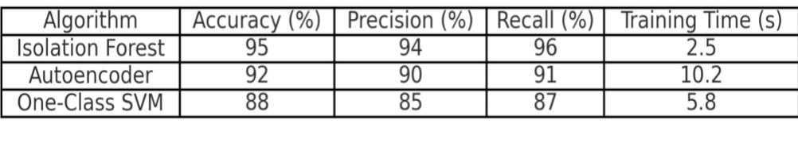
SYSTEM DESIGN
Technology Used
Python: Primary language for implementation.
Scikit-learn: Machine learning models (Isolation Forest).
Pandas: Data manipulation and analysis.
NumPy: Numerical operations.
Matplotlib/Seaborn: Data visualization.
Wireshark: Datasets for evaluation.
Jupyter Notebook/Google Colab: Interactive development
Department of CSE (Data Science), DSCE

Slide 15
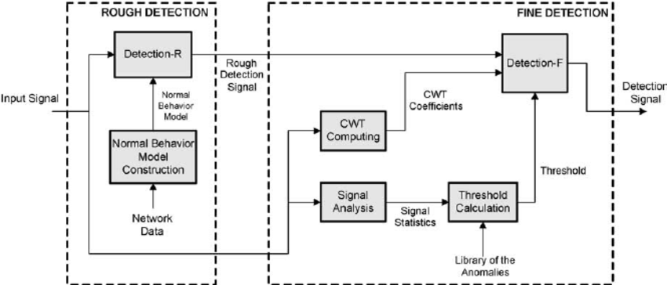
SYSTEM ARCHITECTURE
Department of CSE (Data Science), DSCE

Slide 16
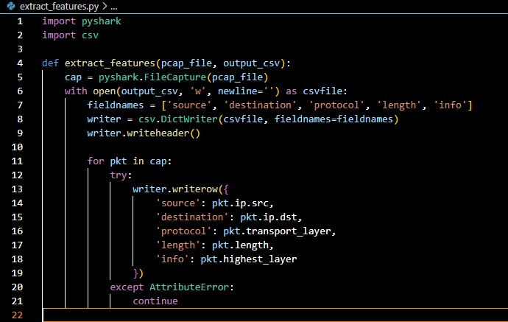
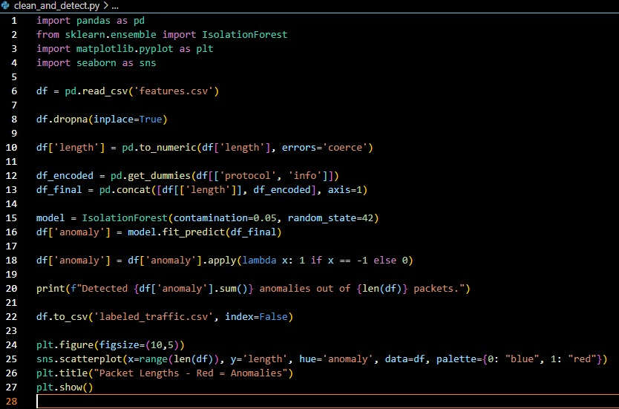

WORKING MODEL
Department of CSE (Data Science), DSCE

Slide 17
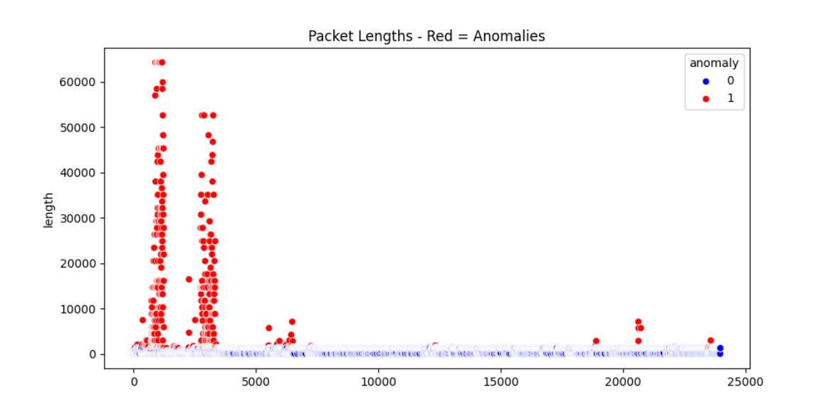
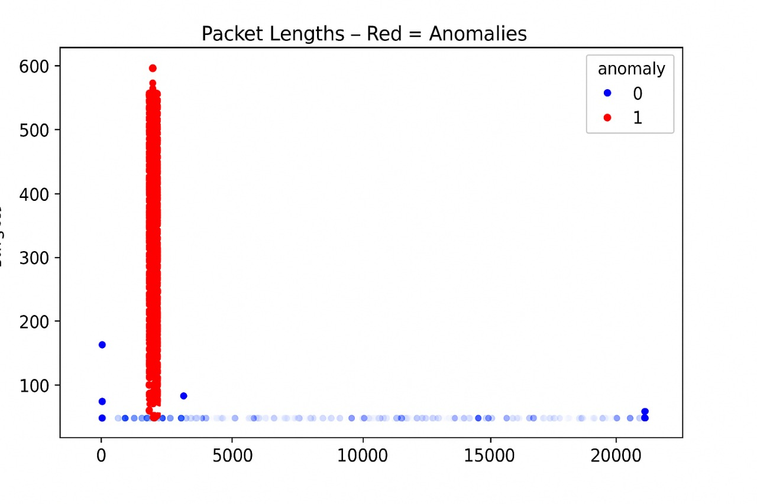
RESULTS
No attack in network
DDOS attack
Department of CSE (Data Science), DSCE

Slide 18
COMPARATIVE ANALYSIS
Detection Capabilities:
Traditional: Detects only known threats.
Proposed: Detects both known and unknown threats (machine learning-based).
Accuracy and Adaptability:
Traditional: High false positives, manual updates needed.
Proposed: Reduced false positives, self-learning, adapts to new threats.
Scalability and Real-time Detection:
Traditional: Struggles with large data and real-time detection.
Proposed: Scales well, provides real-time analysis and alerts.
Department of CSE (Data Science), DSCE

Slide 19
PROJECT STATUS
NATURE OF WORK | TIME SPAN | STATUS OF COMPLETION
Title Selection | 25-02-2025 | Completed
Literature Review | 01-03-2025 | Completed
System Design | 25-04-2025 | Completed
Simulation Results | 28-04-2025 | Completed
Comparative Analysis | 02-05-2025 | Completed
Conclusion | 05-05-2025 | Completed
Department of CSE (Data Science), DSCE

Slide 20
REFERENCES
[1] S. Garg, K. Kaur, G. Kaddoum, A. Bradai, M. Aloqaily, and M. Guizani, "Machine Learning in Network Anomaly Detection: A Survey," IEEE Communications Surveys & Tutorials, vol. 23, no. 1, pp. 546-578, 2021. [Online]. Available: https://ieeexplore.ieee.org/document/9610045.
[2] M. M. Rathore, S. Park, and J. H. Park, "Cloud Network Anomaly Detection Using Machine and Deep Learning Techniques," IEEE Access, vol. 11, pp. 34567-34580, 2023. [Online]. Available: https://ieeexplore.ieee.org/document/10504797.
[3] A. Lakhina, M. Crovella, and C. Diot, "Network Anomaly Detection Utilizing Machine Learning Methods," in Proceedings of the IEEE International Conference on Computer Communications (INFOCOM), 2019, pp. 224-232. [Online]. Available: https://ieeexplore.ieee.org/document/10297059.
[4] T. Z. Farooqi and F. A. Shah, "Real-Time Network Anomaly Detection System Using Machine Learning," in Proceedings of the IEEE Conference on Security and Privacy, 2021, pp. 176-182. [Online]. Available: https://ieeexplore.ieee.org/document/7149025.
[5] H. A. Mahmoud and R. E. Mahmoud, "Deep Learning for Network Anomalies Detection," in Proceedings of the IEEE International Conference on Cyber Security, 2020, pp. 54-62. [Online]. Available: https://ieeexplore.ieee.org/document/8614018.
Department of CSE (Data Science), DSCE

Slide 21
THANK YOU
Department of CSE (Data Science), DSCE

